Slide 1
Writing Word Equations

Slide 2
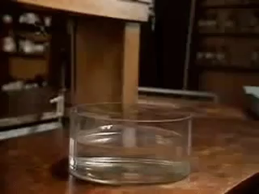
By the end of this lesson, you should be able to:
Write a chemical equation based on a description of a reaction.
Interpret chemical equations.

Slide 3
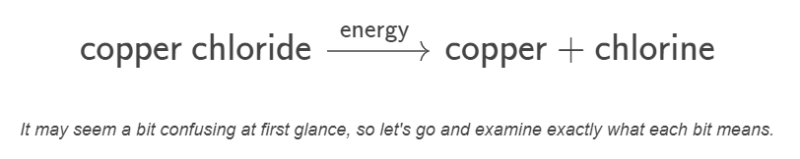
Diagrams showing the relationships between reactants and products are called chemical equations.
A chemical equation is how we display the chemicals involved in a reaction. The following is an example of a word equation:

Slide 4
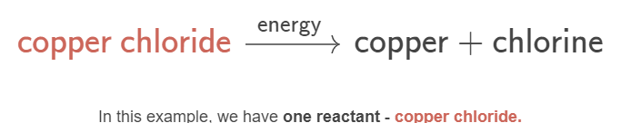
Reactants always go on the left in word equations.
Chemical reactions always have at least one reactant. Therefore, word equations always contain at least one reactant.
The coloured part in the word equation below is the reactant in this reaction:

Slide 5

The arrow in a chemical equation symbolises the reaction taking place.
The next part of our word equation we need to understand is the arrow:
You always need an arrow and it always points to the right, away from the reactants, since those always come before a reaction.
Sometimes you can put words above or below the arrow - these are chemicals or influences which are not part of the reaction but help it to happen.

Slide 6

Products are always located to the right of the arrow.
The final part of our word equation is the product(s). There is always at least one product in a chemical reaction. Thus, there is always at least one product in a chemical equation.
In this example, we have two products - copper and chlorine gas.
If there is more than one product, we place a plus symbol between them. This is also true of reactants.

Slide 7

We can now construct word equations based on statements such as:
"We started with a solution of copper chloride. The energy of the solution was increased by heating, and it reacted by decaying into copper metal and chlorine gas."
This statement communicates the reactants, the products and the external factors that helped the reaction along. We can arrange this information into the following equation:

Slide 8

In summary, follow these steps to write a chemical equation:
1. | Place the reactants on the left.
2. | Draw an arrow to the right. If there are any external factors such as chemicals or conditions that helped the chemical reaction along, place these above the arrow.
3. | Place the products on the right of the arrow.

